Slide 1
Quiz from Last Week

Slide 2
Lecture 9
Graphs

Slide 3
Graphs
A graph is a data structure for representing connections among items
Consists of vertices connected by edges
A vertex (or node) represents an item in a graph.
An edge represents a connection between two vertices in a graph

Slide 4
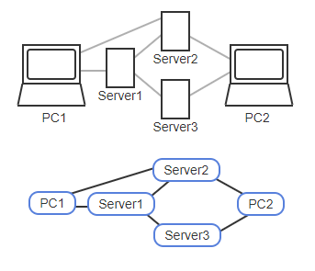
Graph Example

Slide 5
Graphs
For a given graph, the number of vertices is commonly represented as V, and the number of edges as E
Two vertices are considered “adjacent” if they are connected by an edge
A path is a sequence of edges leading from a source vertex to a destination vertex
The distance between two vertices is the number of edges on the shortest path between them

Slide 6
Adjacency List Approach
Various approaches exist for representing a graph data structure in your code
A common approach is an adjacency list
Each vertex has a list of adjacent vertices
A key advantage to this type is that each vertex appears once and edge appears twice
This is less memory space needed than some other methods

Slide 7
Adjacency List Approach
A disadvantage to this method however, is that determining whether two vertices are adjacent requires searching one vertex’s adjacency list
Which could be up to size V
In many graphs, nodes are only connected to a few other nodes so this isn’t a big problem

Slide 8
Sparse Graphs
Graphs where the majority of vertices are only connected to a small fraction of other vertices are called “sparse graphs”
Sparse graphs have far fewer edges than the maximum possible
Examples:
Computer networks, flights between cities, friendships among people

Slide 9
Adjacency Matrix Approach
Another way to represent a graph data structure is to use an adjacency matrix
Each vertex is assigned to a matrix row and column, and a matrix element is 1 if the corresponding two vertices have an edge or is 0 otherwise.

Slide 10
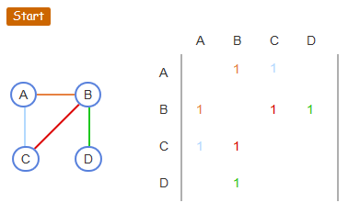
Adjacency Matrix

Slide 11
Adjacency Matrix Pros and Cons
An adjacency matrix’s key benefit is an O(1) determination of whether two vertices are adjacent
The place in the table where the two intersect is quickly and easily checked
The downside is that the matrix size can be very large since it is a function of the number of vertices squared O(V²)

Slide 12
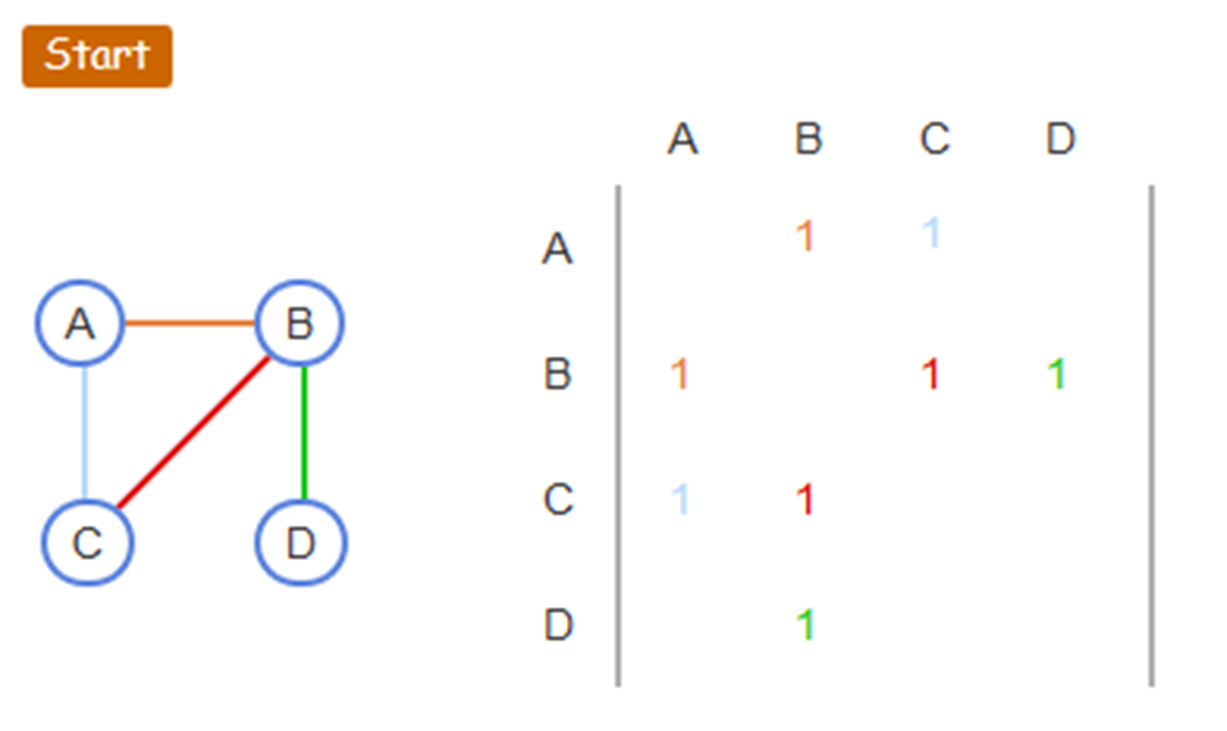
Adjacency Matrix Pros and Cons
An adjacency matrix would be inefficient for a sparse graph in which most elements would be 0’s.
Half of this matrix is unused

Slide 13
Directed Graph
A directed graph (digraph) consists of vertices connected by edges that specify a direction
i.e. links between web pages, college prerequisite flow chart
A path is a sequence of directed edges from a source to a destination vertex
A cycle is a path that starts and ends at the same vertex

Slide 14
Weighted Graph
A weighted graph associates a weight with each edge
The weight is some numerical value between vertex items
i.e. connection speed between computers, flight cost between airports
A weighted graph may be directed or undirected

Slide 15
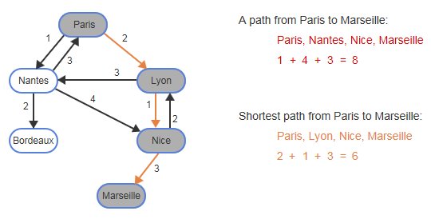
Weighted Digraph

Slide 16
Paths and Cycles
The path length is the sum of the edge weights in the path
A cycle is a path that starts and ends at the same vertex
The cycle length is the sum of the edge weights in a cycle
A shortest path does not exist in a graph with a negative edge weight cycle
Each loop around the negative will make the path “shorter” in a mathematical sense

Slide 17

Negative Edge Weight Cycle

Slide 18
Example Video
Graph Video
Start video at 7:43

Slide 19
Zybook Sections
5.1-5.4
5.7
5.8

Slide 20
Quiz this Week
Graphs

Slide 21
Assignment this Week
Graphs

